Slide 1

Paperplane Website Status Report
Team name : Techno Knights
Team Number : 24

Slide 2


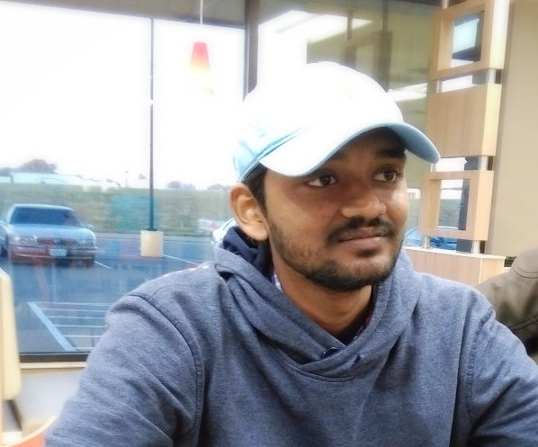
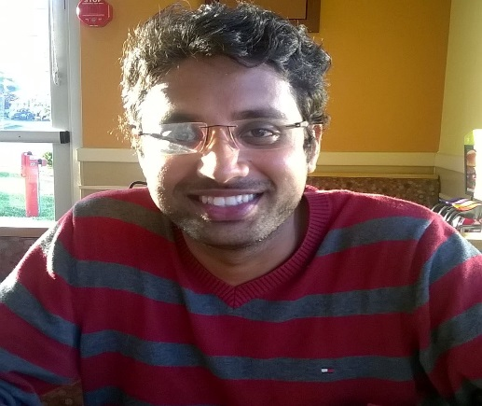
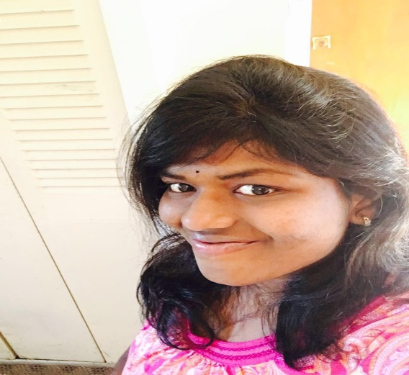

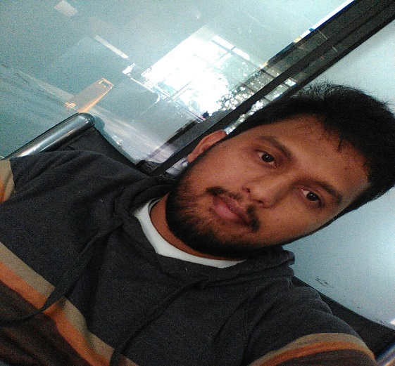
Team Members
Bhanu Teja Kurucheti
Sai Raj Kiran Kandula
Sai Sumanth Kattekola
Hima Teja Gutta
Sravya Madarapu
Vamshinath Nallamothu
Adarsh Kumar Reddy Pidaparthy

Slide 3
Team member responsibilities
Primary Contact - Vamshinath Nallamothu
Client management - Bhanu Teja Kurucheti
Requirements management: - Hima Teja Gutta
Data management - Sravya Madarapu
Issues management - Sai Sumanth Kattekola
Quality and testing management - Adarsh Pidaparty
Communications and
documentation management - Sai Raj Kiran Kandula

Slide 4
Overview
Tasks accomplished
Work in progress
Challenges faced
Work in Queue

Slide 5
Tasks accomplished
Developed homepage with links to settings, login/sign up and contact us.
Itinerary plan can be generated based on destination.
Integrated Google maps API to generate itinerary plan along with Google maps and directions .
Validations for all user entry.
Developed User settings and travel settings functionalities.

Slide 6
Work in progress
Pointing the places on maps from the JSON data using place ids
Drawing polyline connecting the places using their place ids

Slide 7
Challenges Faced
Converting points provided in JSON to latitude and longitude to plot the polyline.

Slide 8
Work in Queue
Figure out a way to work with points provided in JSON.
Integrate web services once provided by the server team.

Slide 9


Slide 10
Questions?

